Slide 1
Using data to shape institutional practices
@EIT
Notes:
E nga muka tangata
Kua rangitamirotia nei
E tu tatou kaupapa huia kaimanawa
Tena Koutou katoa
Ko Patrick Jones toku ingoa
No Te Aho a Maui ahau
A pleasure to be here, looking forward, with an eye to my past

Slide 2
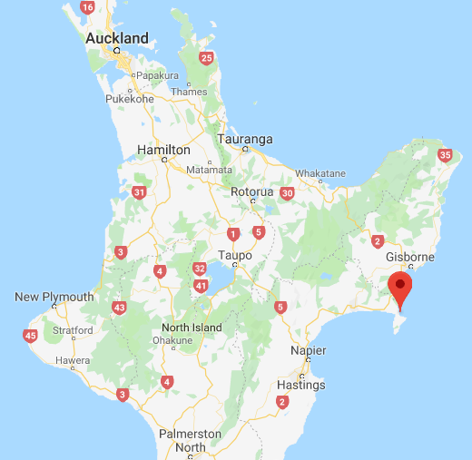
Notes:
Talk about where I come from, the context of our merger in today’s discussion and sector environment. The skills it bought me and us both personally and professionally. And now they send rockets into space from Mahia. NZIST.

Slide 3
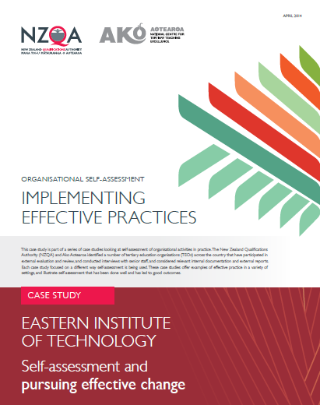
Notes:
Quickly reference this document, even today it is relevant

Slide 4
A key moment 2010/2011
Merger – looking back, how was data used in the merger to shape what we wanted to/needed to be?
  Look ahead at what our cohorts would look like
  Set principles
  Genuine self assessment
  Learn from each other
  Lead to strategic intent
  Lead to action
Notes:
A reflection on the merger and the role of data in that

Slide 5
Change in Māori population by age, next ten years
Hawke’s Bay
Tairāwhiti
Notes:
Begin my presentation on how data informed our last decade of progress.
Firstly, what did the data tell us about who our cohorts were going to be
This data, produced shortly post merger was used to understand something very key, that HB was going to change more significantly that Tairawhiti. And therefore, what could we learn from the Tairawhiti context that was going to become important in HB?
It informed primarily, discussion and training of HB staff, but not as an isolated one off, but to become the “way that things are done here”.
The merger also involved a significant deep dive into the EPI data of both organsiations, and whilst this informed decision makers and how data was published/talked about, what it actually informed was the differences both positive and not so OK between organisations AND combined still behind other similar orgs in the sector.

Slide 6
EIT data principles (est 2009)
we will adopt and pursue any administrative or structural (to qualifications) changes that improve our performance;
we will use the data to identify where we need to adopt improved teaching and learning strategies to lift performance, and support effective learning;
we will use the data to determine where we are ineffective and question whether we continue with low performing programmes;
we will not, however, avoid ‘hard to succeed’ cohorts of students or difficult communities as a way of lifting our EPIs, and will accept that retained commitment to those communities will have an adverse impact on our EPIs;
we will not ‘game’, such as, by only pursuing easy to achieve courses or students, to lift our EPI data;
we will not compromise on our academic standards for the intention of improving performance indicator data.
Notes:
And so (CEO) established these key principles and they have not been altered since. We still to this day reflect on them and abide by them,

Slide 7
A brief history: Business Intelligence & Learning Analytics @EIT
EIT’s use of learning analytics to date:
  Merger/Self Assessment as key drivers, using data to inform those discussions
  Data generally related to Macro-level behaviours, trends (see next slide)
  Data increasingly informing strategic decisions, processes (learning to close the loop), and development of space and people
  Greater analytical capability with data sets/sources, e.g. Revive
Where EIT is moving:
  Understanding the learner journey/experience better
  Product/programme design, development, assessment
TANZ eCampus:
  Data-driven insight
  Data warehousing –ability to deploy back into ITPs
  Machine Learning, Predictive & Prescriptive Analytics

Slide 8
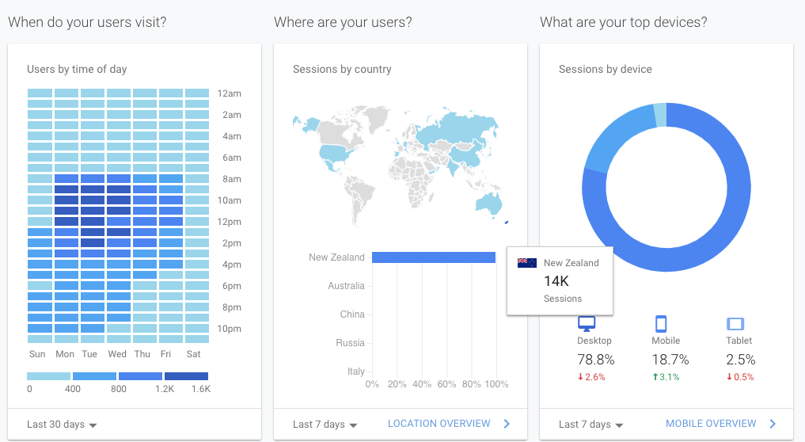
First foray into analytics……..
So what kind of practices were shaped because of this?
Notes:
Developed an innovated application that allowed us to apply available analytical services to our online environments.
Allowed us to see into the “black box” of our learning management system, and understand how our learners were engaging online, where, when, and with what. Now we have 7 years of data. Provided a new evidence stream to use. Could begin to tell the story of who we are and what was happening in new ways.
This analytical capability contributed significantly to shaping IT and teaching and learning at EIT: impact of mobile and networking, learning design, activity and resource design, blended delivery, interaction design, teaching and learning research, learner support and role design.
Producing new ways of collaborating and sense-making together – new opportunities for dialogue and action. Very much aligned to our culture and how we aspire to be.
This way of working helped disarm the anxiety around data use. This new capability was seen as a new “evidence engine” for self assessment and continuous improvement.

Slide 9
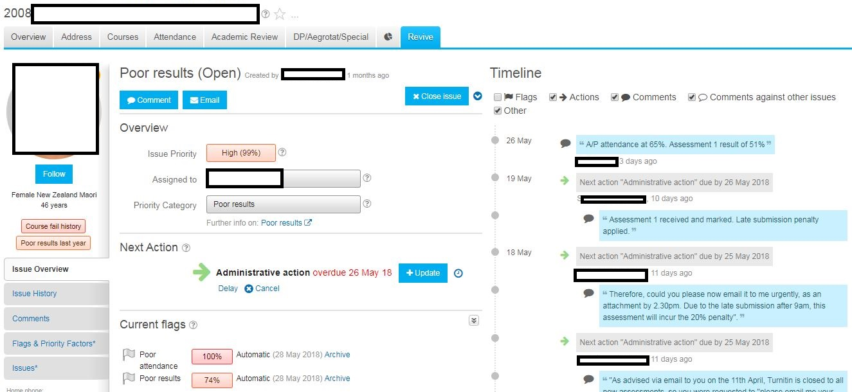
………then came “Revive”
Our first efforts to combine data already captured, attendance, bio data, results data
Notes:
aPlus+ Revive is a software solution that constantly monitors our entire student population to identify those students who are not doing so well and would benefit from our help, and provides a complete framework to manage and track intervention.
Introduced around 2004, firstly in trades, where a desire existing to formally track and share info that was informally known and kept.
It opens “issues” that allow a human intervention. The issue might arise automatically (attendance/low/fail result) or be manually opened.
What’s important at EIT is that it is still a human intervention

Slide 10
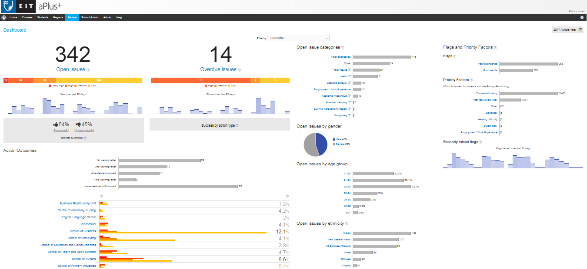
And where to now for Revive?
So what kind of practices were shaped because of Revive?
Notes:
Informing a full repository to support materials and training opportunities for staff.
Ensuring a collective response to student pastoral care. Assisting where appropriate an all of EIT and whanau approach to supporting some students.
Informing where we put our resources
Informing discussions with funders and policy makers

Slide 11
So were we “right”?
What actually happened/is happening?

Slide 12
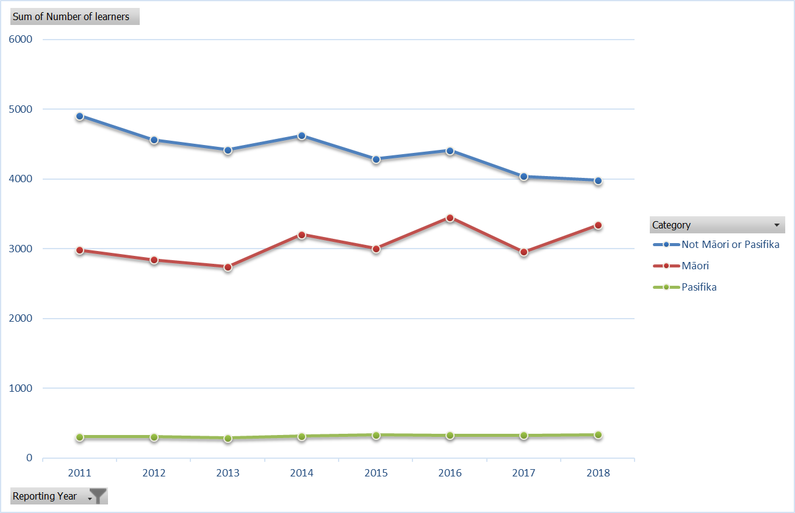
How have our cohorts changed?
Notes:
And so what, were our predictions around cohorts correct? Yes – and that growth came in HB. Would we have seen that if we had not learned from our merger?

Slide 13
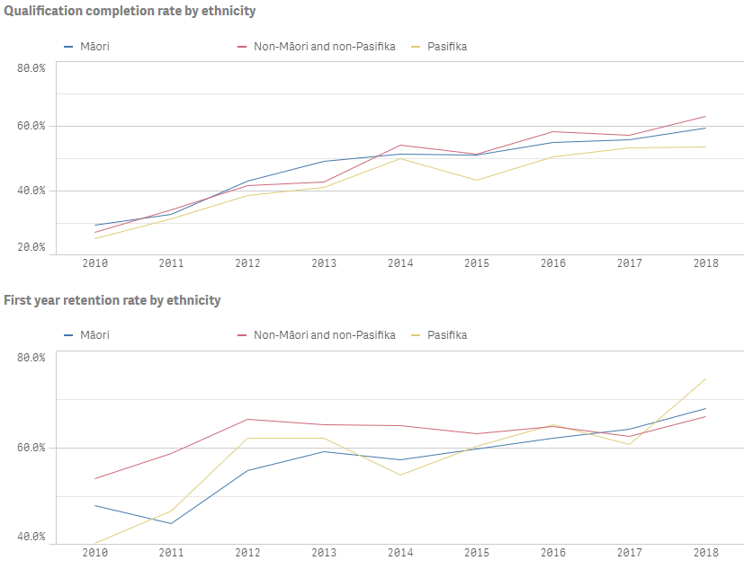
Performance; Where were we in 2010/2011?
Notes:
And has it impacted our performance for Maori?

Slide 14
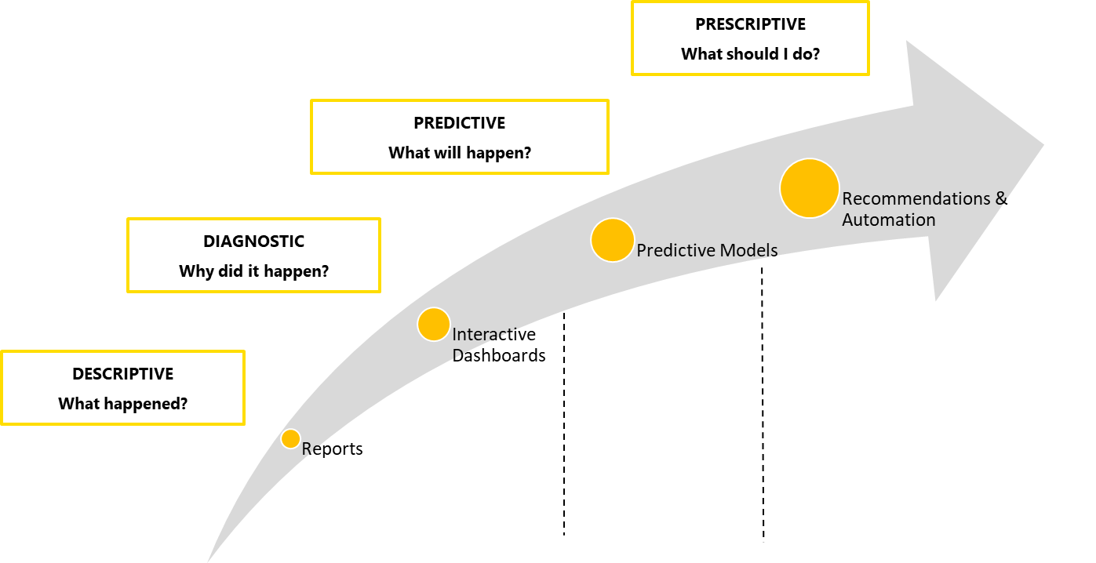
And the now/future; Collaboration.
TANZ eCampus:
Notes:
Who is TANZ - TANZ eCampus is a flexible online learning service
OP, ARA, NMIT, UCOL, EIT, TOI OHU MAI, NORTHTEC. What is being achieved together could not have been achieved alone.
Our TANZ eCampus culture has shaped how we got to where we have and how we did it.
TANZ eCampus trajectory—now working in the predictive/prescriptive space.
Key question for the team: How can we help others to be more successful at what they do?
Focus on actionable intelligence—how can we get really good at turning insights into actions?
Building on our experiences with using data from across seven ITPs and within our online environments
Developed scalable architecture: allows for extendable number of Machine Learning and rules-based engine outputs.
Think Revive, but we can apply that to anything
Able to do more--innovate and move faster (including developing Data Governance, Master Data Management and Data Stewardship practices)
Collaborating with our partners—access to data services, policy frameworks, architecture/infrastructure, data models, talent and expertise.
Building confidence, trust, in what we are creating.
Establish ways of working that produces value—helping others to be successful, helping to solve their business problems

Slide 15
TANZ eCampus: Learning Analytics
Key strategic component of TANZ eCampus
Data warehouse approach—7 ITPs
“Evidence engine” for continuous improvement
Approach to learning analytics is informed by four key concepts:
  The Learner and their personalised learning experience
  Transparency of data for learning and decision making
  Use of models that facilitate success
  Data Governance/stewardship

Slide 16
eCampus and shaping practices
What is TANZ eCampus BI and LA shaping?
  Collaboration, partnerships-–ways of working together
  Capabilities to turn insights into action
  Governance and Stewardship of Data
  Learning, product, experience design
  Learner support
  Data services
Notes:
Exposes us (the TANZ network) to new ways of working with data—new possibilities and opportunities
On a journey together, learning together--not in silos or isolation—don’t have to carry this alone
Access to technologies, expertise, services
Analytical capabilities now enabling us to rethink how we do things across a range of areas

Slide 17
Summary
Practices will be shaped and change shape continuously. Consistency vs Uniformity
What's important is the receptiveness of those practices to what the data says
So a culture of data informed discussions is essential

Slide 18
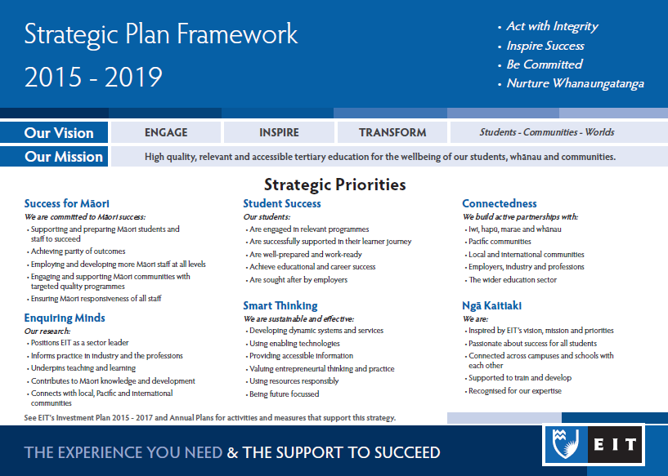
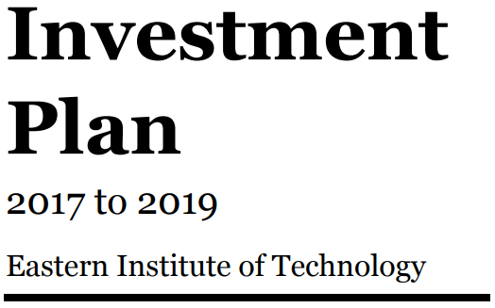
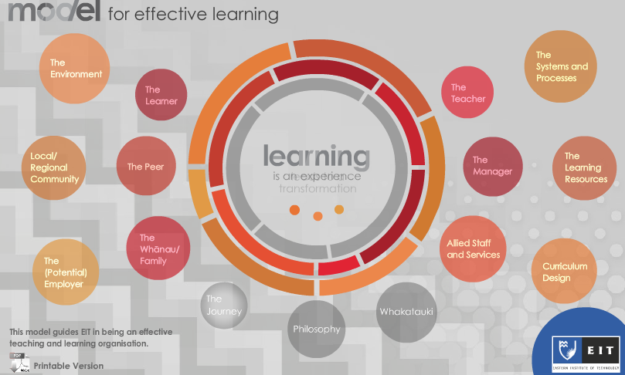
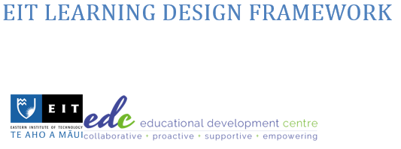

So what does that culture look like?
Notes:
It looks like an organsation that aligns all of its intent framework around what it believes to be important. This will be talked to more by my CEO tomorrow

Slide 19
Lessons learned (and still being learnt)
Culture of constant and frank self assessment across all activity
  Data use principles
Engagement in the community
  Use the data to generate discussion/feedback/debate
Be involved in new initiatives/pilots/policies; they will test you and broaden perspectives
  E.g. Secondary/Tertiary interface
Invest when/if you can; use what resources you do have
Report on your successes and failures – accountability
  Staff, students, communities, Executive, Council, other leadership forums

