Slide 1
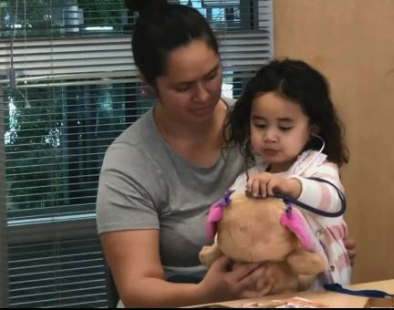
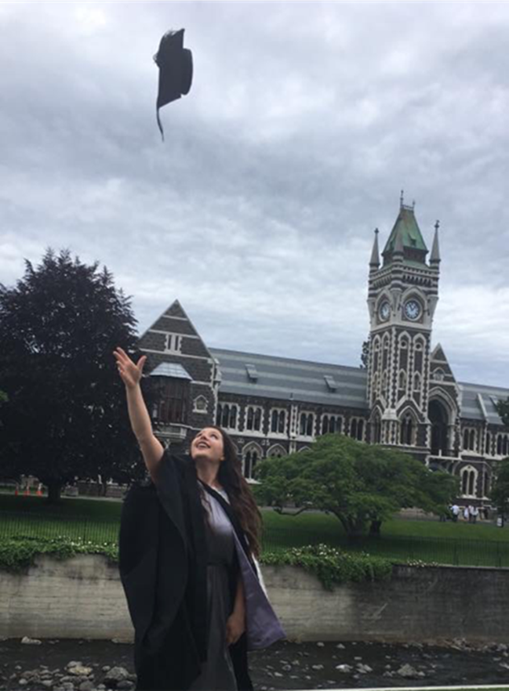
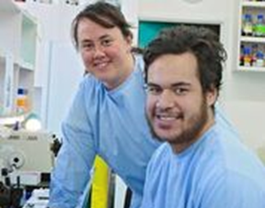

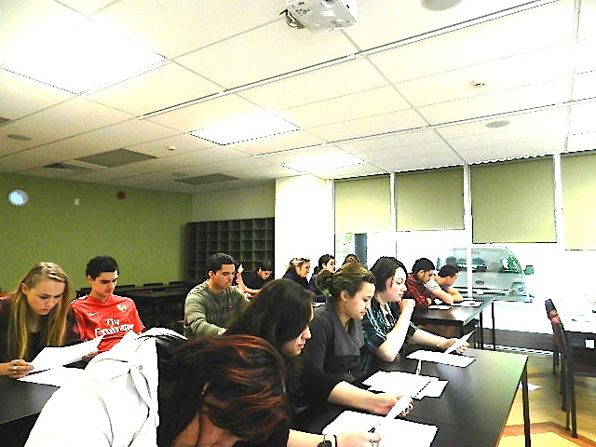


Māori Student Success in Health Sciences
– From inspiration to graduation…..
August 2019
Joanne Baxter, Zoe Bristowe
Kōhatu, Centre for Hauora Māori
Māori Health Workforce Development Unit
Division of Health Sciences, University of Otago

Slide 2
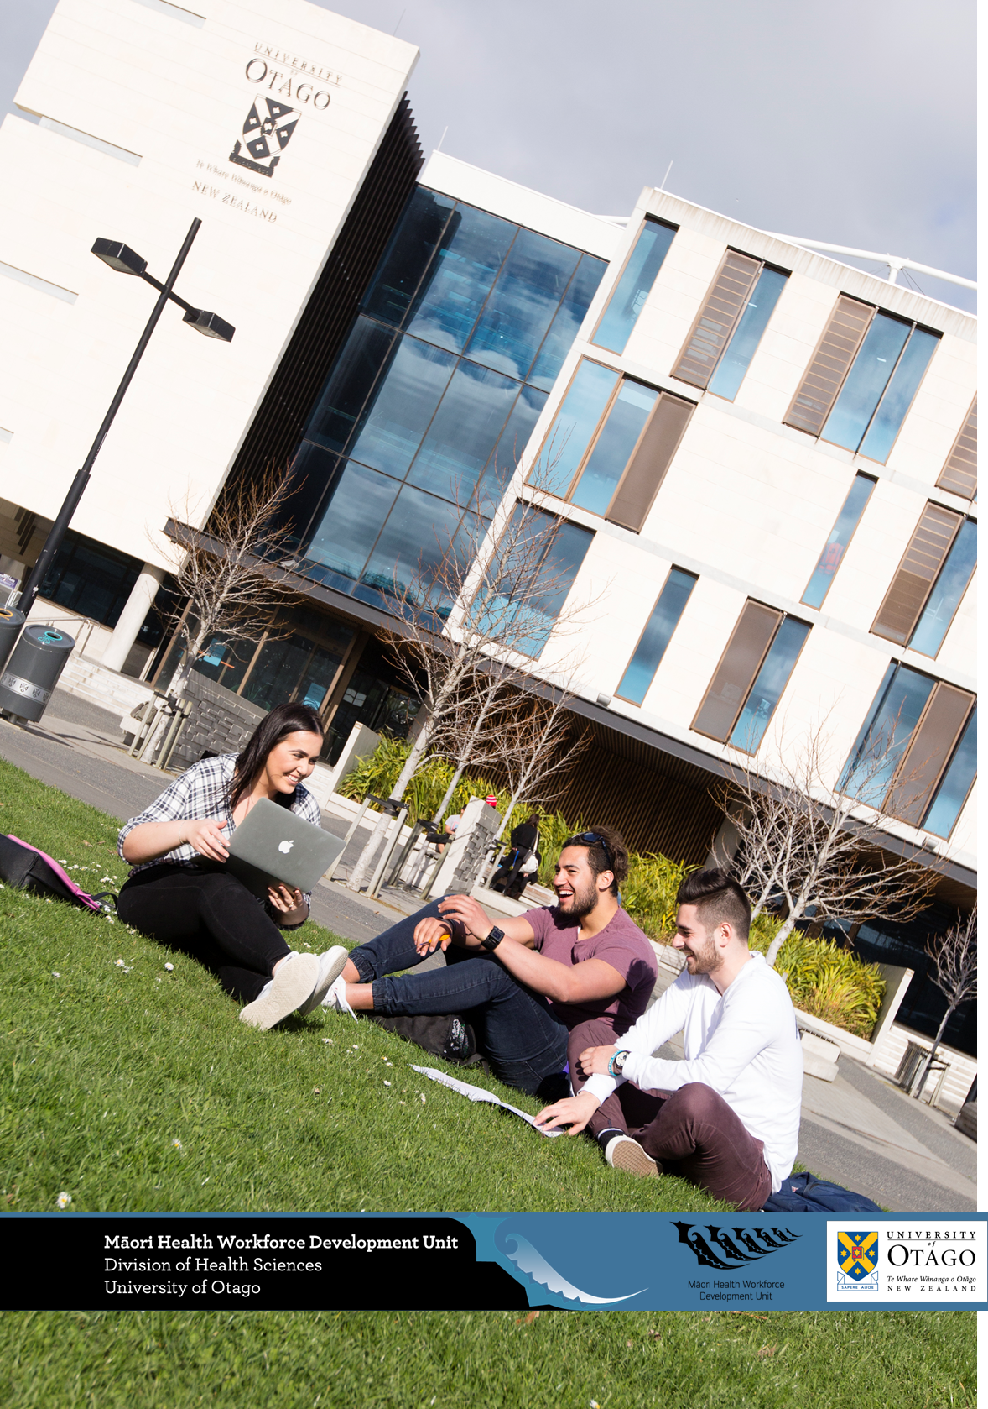
      Context
      Transition Programmes
      Outcomes
      Learnings

Slide 3

Population and Health Context
Health Workforce
MĀORI
15 % total population
Between 2-5% of NZ’s
Dentists,
Doctors,
Physiotherapists,
Pharmacists,
Oral health practitioners
<2% Radiation therapists, Laboratory scientists
25 % of children
28 % of babies born

Slide 4


Otago’s Division of Health Sciences
Division of Health Science – 7 Schools, >6,500 students
Health Science degrees
  BSc –biomedical sciences
  Bachelor Health Science (Major Māori Health)
Health Professional degrees
  Medicine
  Medical Laboratory Science
  Dentistry / Oral Health / Dental Tech
  Physiotherapy
  Pharmacy
  Radiation Therapy (Wngtn)
Post-graduate
  Research
  Nursing
  Taught eg Public health
Notes:
Otago’s health qualifications feed directly into health workforce NZ. Only school of dent and RT

Slide 5
Competitive entry
Health Professional Programme Entry
Dentistry
Medicine
Pharmacy
Physiotherapy
Medical Laboratory Science
Radiation Therapy
Oral Health
Dental Technology
Other programmes
Biomedical, Science and Health science degrees
Other Health programmes (University, Polytechnic, Other)
Other Tertiary pathways
Semester One
Chemistry
Physics
Cell Biology
Human Biology 1
Semester Two
Human Biology 2
Biochemistry
Population Health
Health Science First Year
Around 1500 students annually

Slide 6
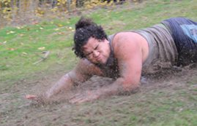
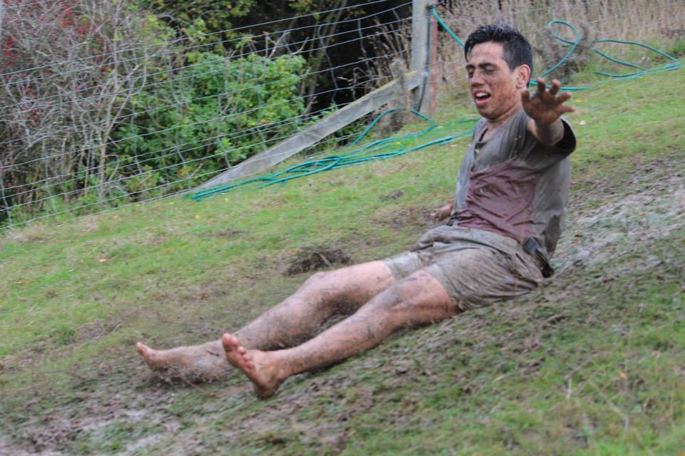
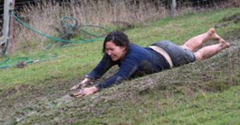
MĀORI STUDENTS: HEALTH SCIENCES FIRST YEAR (HSFY)
PRIOR TO 2011…
Māori HSFY cohorts 2007 – 2010 – relatively few
<1/2 passed 4 papers in Semester 1 (making ineligible for most health professional programmes)
Many changed pathways or discontinued tertiary study
Many with challenges: first in family to come to University, gaps in science attainment and subjects, have gone to low decile schools, financial insecurity

Slide 7
Ōritetanga – Education and Health
Context: Education inequity is a pathway to health workforce inequity
  Gross inequity in Māori entry and completion of tertiary study in health.
  At Otago in 2010 5% students in Health Sciences were Māori (cf 20% of young people in population being Māori)
Solution: Partnership Ministry of Health and University of Otago - increase Māori health science graduates.
Rationale: Increased tertiary success in health will contribute to equity in Māori health AND education.
Notes:
It was difficult trying to condense our research into a handful of slides bc what we do is very broad.
To describe our research in a nutshell we thought it important to be begin with the overarching context / impetus for why we do what we do. Māori are significantly underrepresented in the health sector across all frontline roles and over-represented in terms of health need.
In 2009 Otago Uni partnered with the MoH on the Otago Project, core objectives were to establish MHWDU and increase Māori student recruitment, retention and achievement in HS
Rationale being that more Māori graduates in HS equals more Maori health professionals and health scientists leading to improved Māori health outcomes.
we needed to develop strong student engagement strategy …

Slide 8
MĀORI HEALTH WORKFORCE DEVELOPMENT UNIT
DIVISION OF HEALTH SCIENCES (Est 2010)
Purpose: To increase Māori recruitment, retention & achievement in Health Sciences study at Otago and beyond.
To demonstrably increase the number & diversity of Māori in the NZ health workforce.
10 Year goal: By 2020 at least 20% of students across the Division of Health Sciences are Māori
  Māori led & directed
  Clear strategic plan, programme logic, targets & ‘line of sight’
  Underpinned by Māori values, strengths-based & evidence-informed approach
  Strong social justice agenda (equity targets)
8

Slide 9
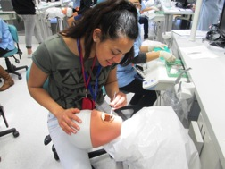
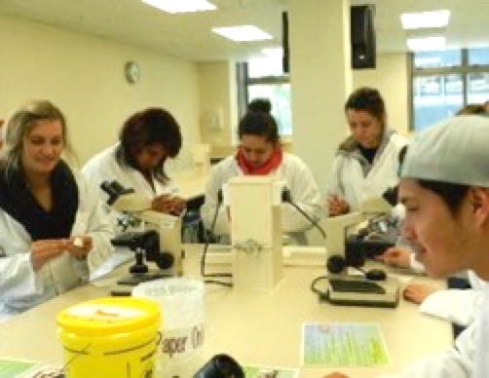
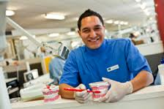
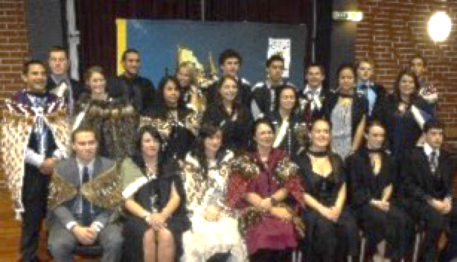
MĀORI HEALTH WORKFORCE DEVELOPMENT UNIT
Te Ara Hauora: Outreach & Recruitment Programmes Yrs 9 -13
Tū Kahika: Foundation Year Scholarship Programme
Tū Tauira Hauora: Māori Health Sciences Degree Support Programme
Te Whakapuāwai: Māori HSFY Support Programme
RESEARCH & EVALUATION
‘From Inspiration to Graduation’
Notes:
Focus on middle 2- front investment

Slide 10
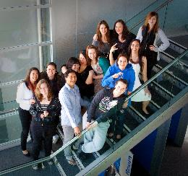
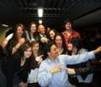
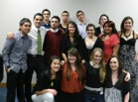



TŪ KAHIKA – Foundation Year Health Sciences Scholarship
Māori school leavers – across Aotearoa
Pre-Health Science First Year ‘Bridging’ Year
Commitment to tertiary study in health however not educationally prepared to face Health Science First Year (HSFY)
Applications August / September year before
Average 18 students per year
TK10 (First Cohort)
Tū Kahika 2010-2015
Notes:
More than a scholarship!

Slide 11
TŪ KAHIKA – Foundation Year Health Sciences Scholarship
Students are provided;
an interview (with whānau) in own community
accommodation in either Studholme or Arana residential college & contribution towards accommodation costs
Foundation Year fees are paid in full
comprehensive additional pastoral & academic support
Both formal support and Tuakana support (older peers)
TK10 (First Cohort)
Tū Kahika 2010-2015
Notes:
More than a scholarship!

Slide 12
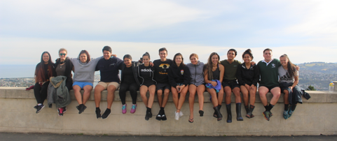
TŪ KAHIKA OUTCOMES
“The feeling that you are part of something bigger than yourself and important is priceless. The support is amazing and everybody is made to feel like they matter in terms of the bigger picture.”

Slide 13
TŪ KAHIKA OUTCOMES
>160 students
>95% successfully complete foundation year
>90% retention in tertiary study
Many Māori health professionals – working across Aotearoa

Slide 14
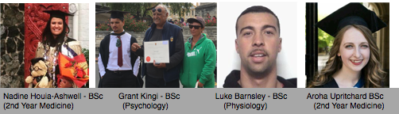

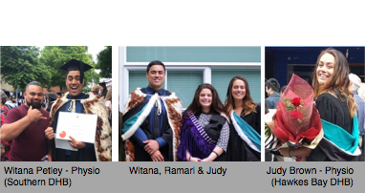

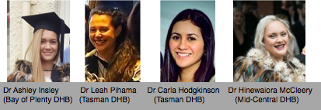
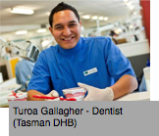
TŪ KAHIKA RECENT GRADUATES

Slide 15
MĀORI HEALTH WORKFORCE DEVELOPMENT UNIT
Te Ara Hauora: Outreach & Recruitment Programmes Yrs 9 -13
Tū Kahika: Foundation Year Scholarship Programme
Tū Tauira Hauora: Māori Health Sciences Degree Support Programme
Te Whakapuāwai: Māori HSFY Support Programme
RESEARCH & EVALUATION
‘From Inspiration to Graduation’
Notes:
Focus on middle 2- front investment

Slide 16
Review - Drivers of inequity
– Barriers to tertiary education in health science
Structural – economic position – impact on education access, affordability, entry
Institutional - education sector outcomes for Māori
  University Entrance (UE) attainment
  Subject preparation e.g science preparation
Tertiary institution accessibility and responsiveness

Slide 17
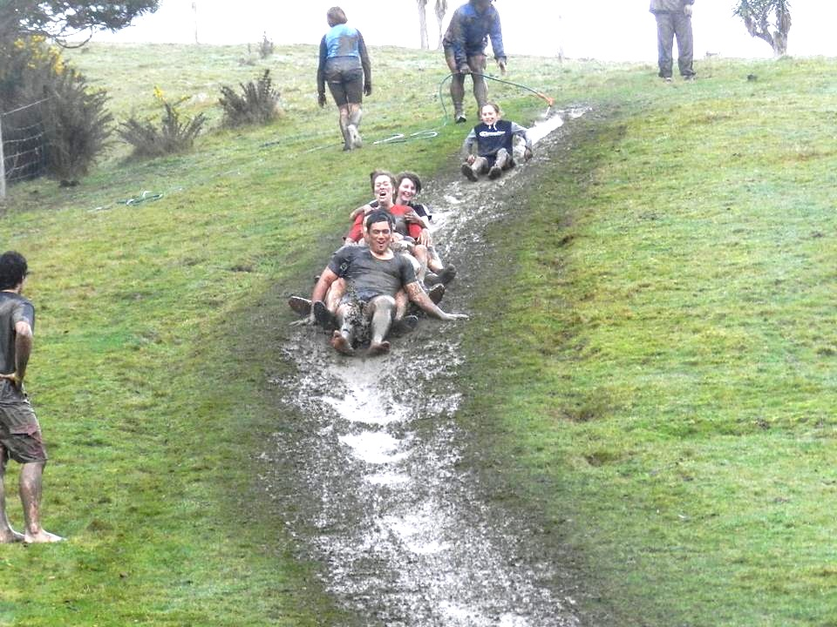
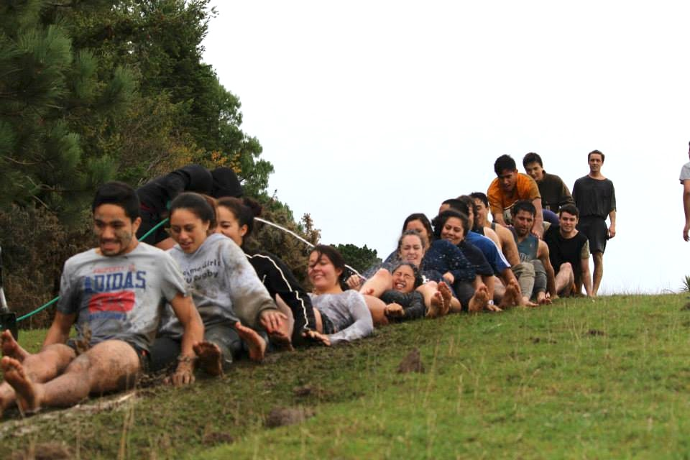
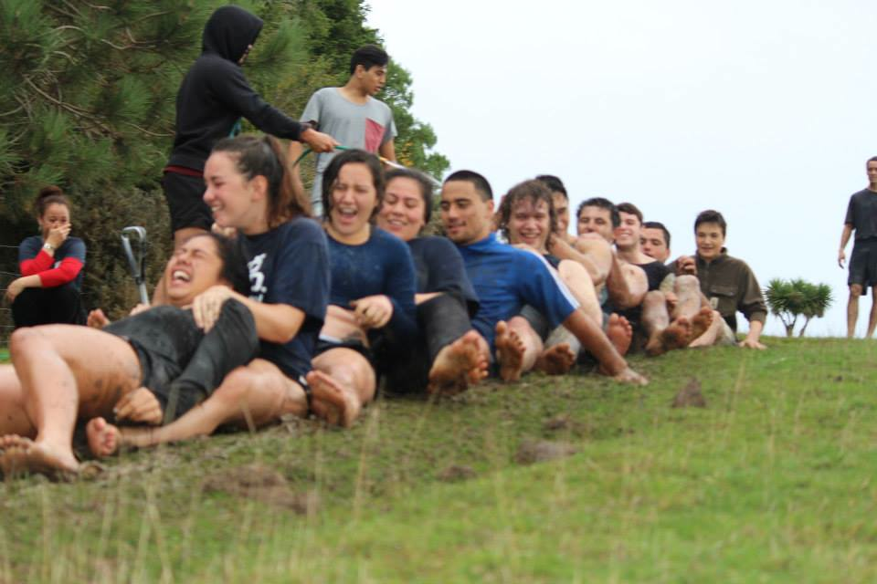
TE WHAKAPUĀWAI: MĀORI Health Science First Year
Strengths based - whole student approach
Māori centred - providing manaaki & fostering whanaungatanga
Knowing each student - responding to group and individual needs
Early contact and assistance with transition into HSFY & Uni
Academic support -tailored and timely and information
Course and career advice
Database – development and maintenance
Student progress - outcomes monitoring
FULL COHORT SUPPORT
GROUP SUPPORT
INDIVIDUAL SUPPORT
Notes:
Unprecedented increase in Māori student progression through HSFY 2011- 2015
Students report Te Whakapuāwai increases sense of belonging & academic confidence for HSFY

Slide 18


Slide 19

WEAVING OUR WORLDS
What is the impact of a strengths + evidenced-based programme upon academic outcomes for Māori Health Science First Year students including those from lower socio-economic backgrounds?
Qualitative & quantitative analysis of HSFY domestic students 2007-2016 experiences & academic outcomes
Tracking academic outcomes pre & post intervention looking at secondary school decile, NZDep2013 and NZQA science credit attainment (over 18,000 students).
Did academic outcomes for Māori HSFY students improve when compared against previous years?
How did outcomes for Māori HSFY students compare against non-Māori & non-Pacific students from ‘similar’ socio-economic backgrounds?

Slide 20
STUDENT PROGRESS DATA
EXPECTATIONS
LOW EXPECTATIONS
CULTURAL INCONGRUITY
‘ONE SIZE FITS ALL’
WORKLOAD
RACISM
STEREOTYPING
PRIVILEGE
$$$$$$$
HABITUS
STRUCTURAL DISADVANTAGE
NCEA
SELF BELIEF
BELIEFS OF OTHERS
DEFICIT FRAMING
ENVIRONMENT
RUMOURS & MYTHS
Notes:
In order to achieve our goals we needed to better understand and unpack the challenges
We drew on a variety of frameworks based on our combined expertise and experience
in Kaupapa Māori
Health (clinical practice & research)
Primary & tertiary education
Teaching
Statistics and Sociology to identify what the challenges were at the macro & micro levels, Drawing on our health and ed backgrounds we were investigating inequities with an understanding of the social determinants of health & education. In essence we were unpacking the context
Key rule for us: Use strengths based inquiry (do not research the ‘problem’ to highlight the problem!). Be transformative, seek evidence based ‘solutions’. Speak to key ‘frontline’ staff. Gather student feedback! Student engagement at the centre, voice as central to shape what approaches we would take t improve the student experience
3. What did ‘success’ look like and how could we emulate that?

Slide 21
TAILORED INFO
STUDENT FEEDBACK!!
TIKANGA
MŌHIOTANGA
MANAAKI
TUĀKANA/TĒINA
KOTAHITANGA
KAITIAKITANGA
EVIDENCE-INFORMED
BEST PRACTICE
WHANAUNGATANGA
AROHA
AKO
HIGH EXPECTATIONS
RANGATIRATANGA
STRENGTHS-BASED
NON-DEFICIT
Notes:
Goal was to redesign & repack the suitcase with all the desired things we wanted that might mitigate the challenges, however what we quickly came to realise is that we didn’t actually want the suitcase at all because it didn’t represent our worldview or the expectations of Māori HS students. Basically the surrounding environment was flawed and we needed to try to address it.
We needed to weave our own kete (whariki) that would better hold (support) the aspirations of Māori, this entailed a lot of collaboration weaving together the various threads of expertise, and student feedback.
Ensuring that Māori values underpinned all aspects of our business model, strategy, planning, operations, programme delivery, evaluation and research and these values are the threads that hold everything together and are the foundations of our practice. What we attempted to do was transform the environment to the best of our ability to better support Māori.

Slide 22
MŌHIOTANGA
TUĀKANA/TĒINA
NON-DEFICIT
HIGH EXPECTATIONS
TIKANGA
TAILORED INFO
MANAAKI
AROHA
STUDENT FEEDBACK!!
KOTAHITANGA
WHANAUNGATANGA
BEST PRACTICE
STRENGTHS-BASED
RANGATIRATANGA
KAITIAKITANGA
AKO
Notes:
So what we did was took our existing programme for Māori HSFY students and theorized a bunch of new components drawing on the international / national literature that might have an impact for all students including those from lower socio-eco backgrounds. Basically we tried to go from novice weavers to master weavers
This was the theory but we needed to put it into practice

Slide 23
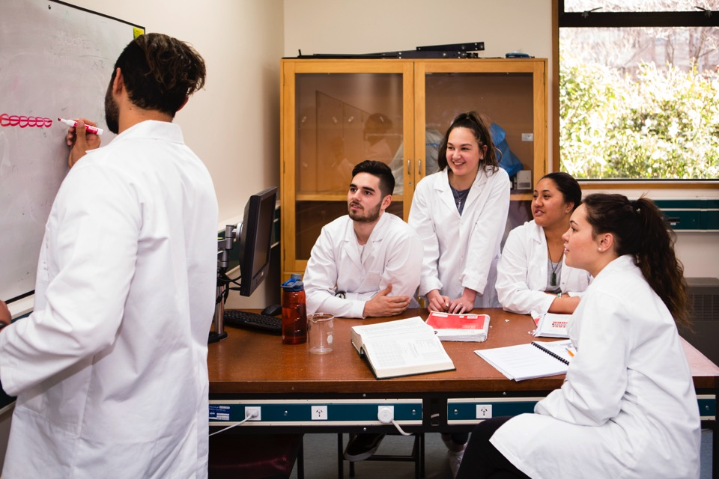
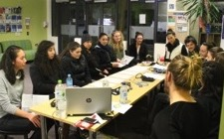
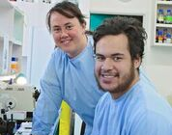
Te Whakapuāwai HSFY Student Support 2014 +
    THEORY: Based on key learnings- Māori pedagogies + identified effective theory & practice to accelerate student learning development & academic success
      Success of existing practice e.g., Tū Kahika
      Māori pedagogies & practice (culturally responsive)
      Anti-deficit & non-remedial
      Peer facilitated study strategy acquisition
      Mindset Theory (Fixed vs Growth)
      Goal Theory (Mastery)
      Self regulated Learning
      Metacognition- ‘thinking about thinking’
      Self Regulated Learning
      Motivation & Self efficacy
Notes:
What is a strength + evidence based approach?
Weaving our Worlds describes our intention to draw on effective pedagogical practice from te ao Maori and te ao whanui to meet the project aims of increasing the academic achievement and progression of Maori learners in HSFY
Through key literature and extensive networks nationally and internationally we are building a comprehensive understanding of what ‘works’ (best practice) to increase student retention and achievement in tertiary study. I our practice we have imported strategies that align with a Kaupapa Maori (non-deficit strength-based approach) to working with Maori learners. We have sought evidence based guidance for this project to actively weave together strengths and evidence from te ao Maori and te ao whanaui.
Many of the theories and practices we have drawn on the enhance Te Whakapuawai and design the weaving our worlds project are based on our current work with students and those that have expertise in this domain working around us, this approach is an accountable commitment to evidence that is informed by data based planning. We have drawn on meta-analysis of predictors of success and empirically validated case studies pertaining to successful strategies to increase academic success (grades)
Predictive power of self efficacy beliefs on student’s academic functioning has been extensively verified through various research and meta-analysis, self efficacy and motivation are shown to be powerful determinants of success. Our goal is to draw on what we know and work with students to increase their motivation, self efficacy, and accelerate the acquisition of study skills, time, emotional and resource management. In essence the focus is on cognitive development and metacognitive skills. Providing an environment that fosters motivation and self efficacy should enable participants to become more effective self regulated learners more swiftly
Goal theory has been used to explain motivational aspects of students’ learning (Pintrich & Schunk, 2002) and has been researched alongside self-concept theory. Both theories appear instrumental in explaining academic achievement, and are useful in explaining the establishment of specific connections between perceptions about a task and the self (Barker, McInerney, & Dowson, 2004). Self concept theory suggests that students will develop more positive academic self concepts as a consequence of academic achievement hence a focus on self-ability, while goal theory suggests self-perceptions about the process of task completion are influential determinants of academic achievement. Implicit theory of ability related to whether or not students have either fixed or malleable views of ability (fixed versus growth mindset) can also impact on receptivity and flexibility; it has been positively related to the development of self-concept and negatively associated with self-handicapping. Students with more malleable views tend to have greater capabilities in terms of acquiring metacognitive and cognitive strategies (Ommundsen, Haugen, & Lund, 2005). (1) self-regulated learners exhibit some kind of control over their behaviours, motivation and affect, and cognition; (2) self-regulated learners are goal-oriented; and (3) self-regulation requires individual ownership of behaviour, motivation and affect, and cognition.
Mindset Theory (Dweck, 2008, 2012) aligns well with the strengths-based/Māori framework approach toward enhanced learner outcomes and is an integral theory driving the vision, design and effective delivery of this project.

Slide 24
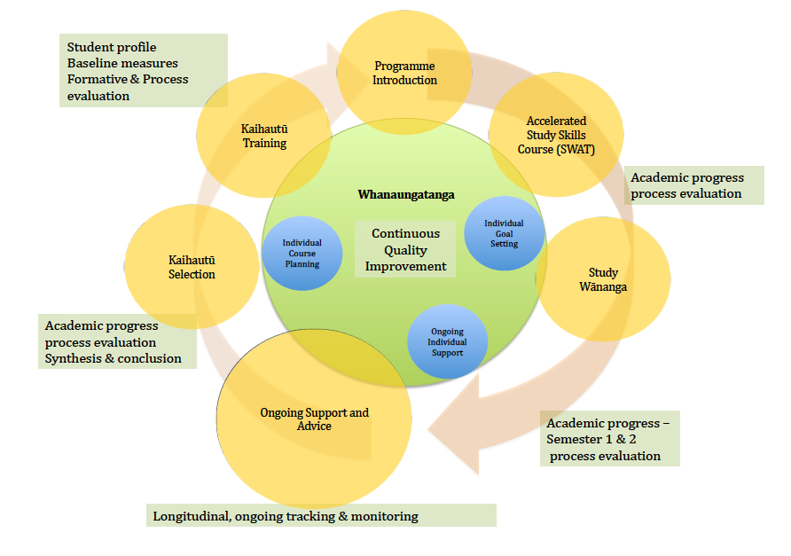
Notes:
Wow map

Slide 25
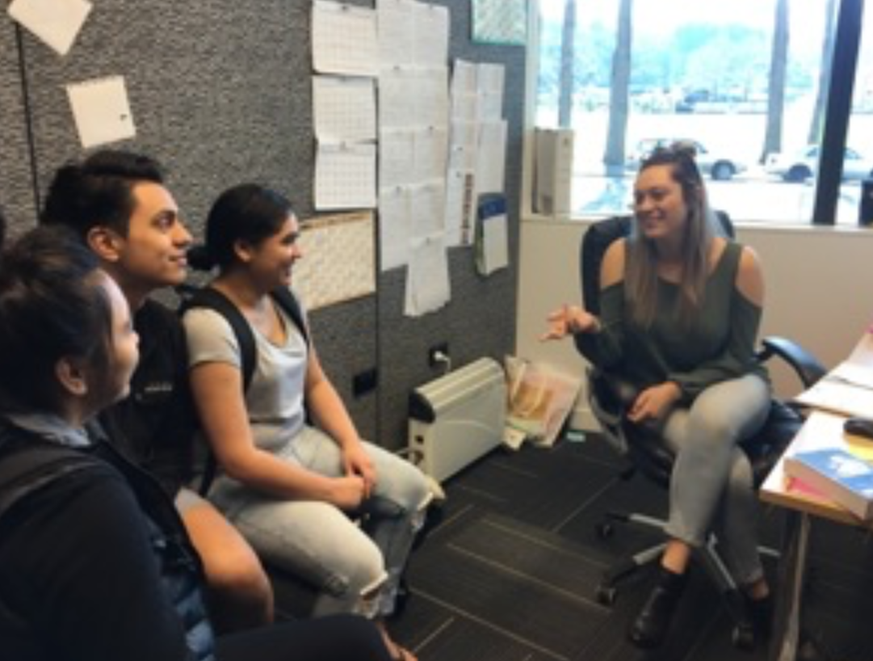
Te Whakapuawai
SWAT (Kaihautū) – Accelerated study skills / Whanaungatanga / Tuakana - Teina
Selection of Kaihautu (Student Mentors/Navigators)
  Near Peers (HSFY the year before)
  Group Interview
  Can articulate their study strategies
  Can talk about Mindset/Intelligence
Training
  De-constructing previous SWAT programme
  Co-construct with direction for staff
Student-Led programme
  Kaihautū meet weekly to discuss the objectives for the SWAT programme
  Kaihautū deliver all aspects of SWAT
Notes:
Key dates to

Slide 26
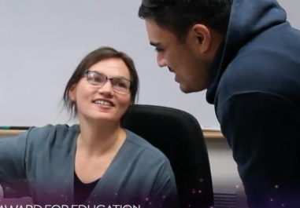
Te Whakapuawai
Individual Support: 1 to 1 interviews
  Semester 1
  Early Contact (Week 1)
    Get to know the student
    Identify academic goals
    Talk about motivation to study
    Time Management Skills
    Hauora / Wellbeing
  Mid Semester Contact
  (Week 6/7)
    Catch up regarding mid-semester grades
    Re-visit Time Management Plan
    Dispel HSFY Myths
  Semester 2
  Follow-up (Week 1)
    Course Advice Specific to Student
    Other Pathways (if Necessary)
Notes:
Key dates to

Slide 27
Te Whakapuawai
Group academic support (partnership Māori Centre)
  Semester 1
  Weekday focused academic / content tutorials
  Weekend – intensive subject wananga
  Semester 2
  Weekly and weekend focused academic tutorials
  Intensive wananga
Notes:
Key dates to

Slide 28
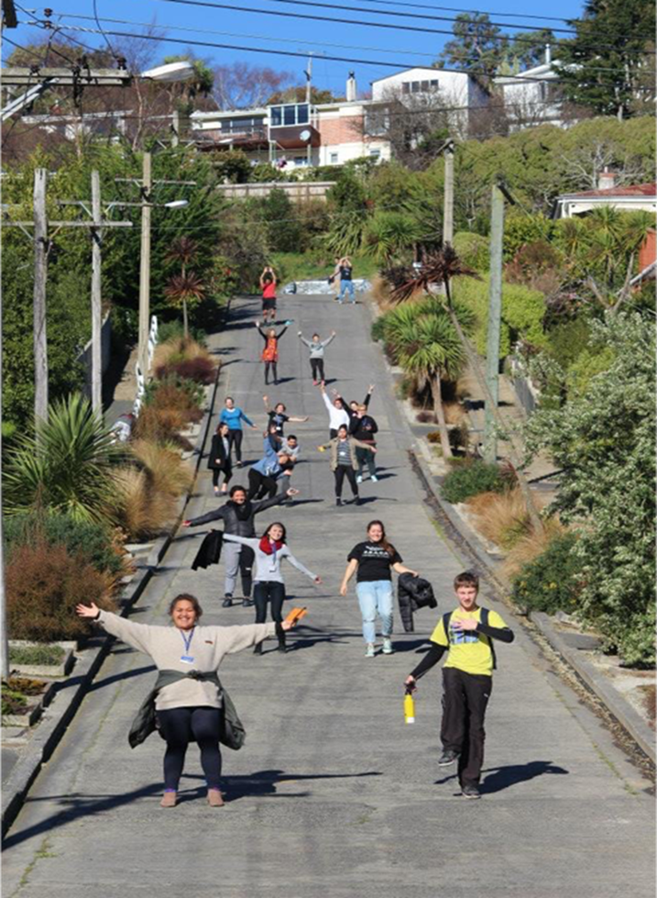
Outcomes
Indicators
  Academic outcomes
    Paper
    Overall
    Semester 1 and 2
  Qualitative – student experience
  Tertiary progression
  Programme entry HSFY +1
  Longitudinal - completion

Slide 29
NUMBER OF MĀORI STUDENTS ENROLLED IN HSFY 2010 - 2019

Slide 30
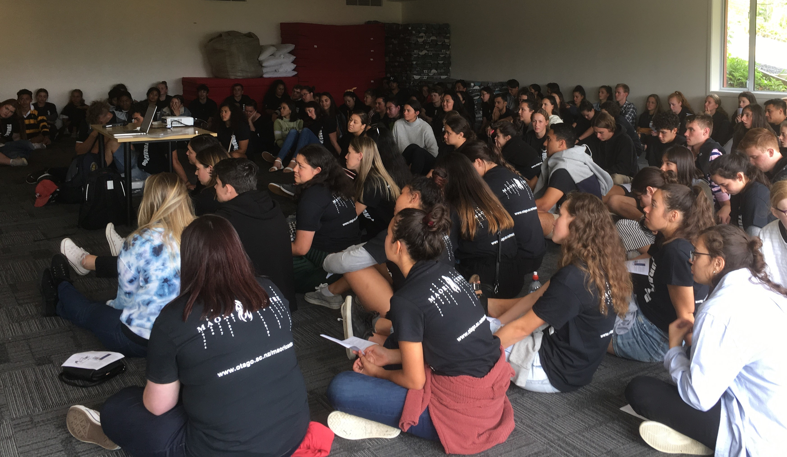
University of Otago Health Science First Year Māori students
Ōtākou marae 2019 (Orientation week)

Slide 31
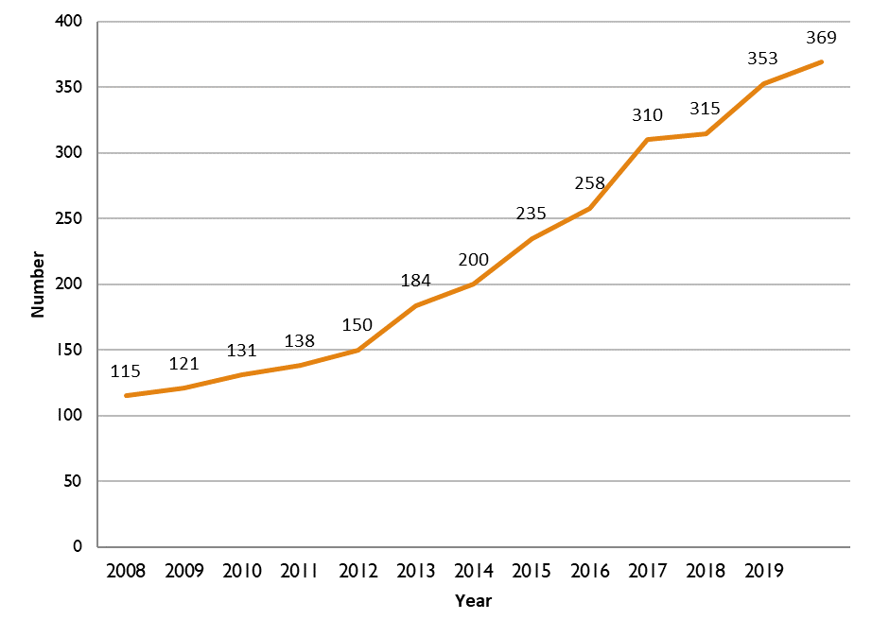
Number of Māori in Health Professional Programmes 2008-2019
Te Whakapuāwai first year student enhanced intensive support programme (Phase 2)
Te Whakapuāwai first year student intensive support programme (Phase 1)
Tu Tauira Hauora, Health Science and Health Professional Programme student success and retention
Establishment Maori Health Workforce Development Unit, Tu Kahika commenced
Te Ara Hauora – Outreach and Recruitment

Slide 32
Number of Māori entering into professional programme directly from HSFY 2008-2019

Slide 34
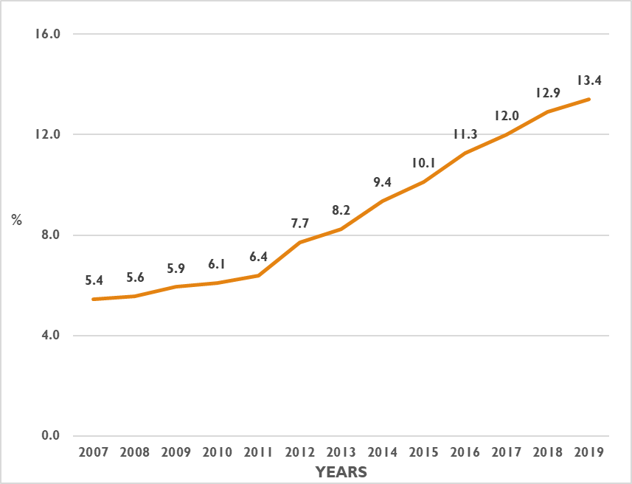
Māori as Percentage of Domestic Health Professional Programmes
2007-2019

Slide 35

Critical Success Factors

Slide 36

Summary - Critical success factors 1
Student and whānau at the centre
Strengths-based (non-deficit) – Unpacking privilege rather than focus on deficit
Māori led & directed
Culturally centred and underpinned by Māori values - Whanaungatanga / Manaakitanga
Knowing each student and the collective
Enabling policy and leadership – systems responsiveness

Slide 37
Summary - Critical success factors 2
  Iterative Praxis: If it doesn’t work rethink and re-try!
Commitment students, staff + whānau
Collaboration / Partnership / Communication
Clear strategic plan, programme logic, targets & ‘line of sight’
Evaluation, evidence and data-informed

Slide 38
Next steps
  Maintaining outcomes with rapid growth
  Continued refinement and tailoring
  Further evaluation and research
  Resourcing and funding – constant issue
  New project - SEQ project (Socio-economic equity project) – all HSFY students from low decile schools (Deciles 1-3) – tailored transition and success programme

Slide 39
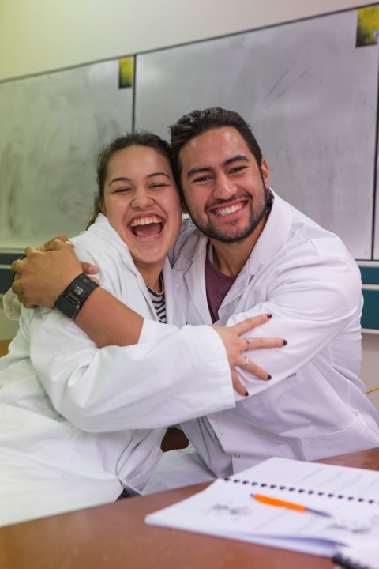
NGĀ MIHI: HUGE THANKS
      Otago’s Māori students!!!!
      Ministry of Health
      AKO Aotearoa
      Division of Health Sciences
      Te Huka Mātauraka
      Residential Colleges
      Funding & Planning
      Thanks to all that continue to support this mahi!

Slide 40
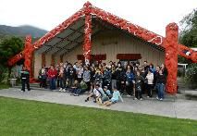
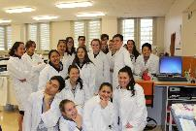
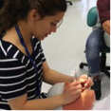
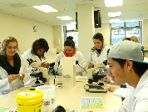
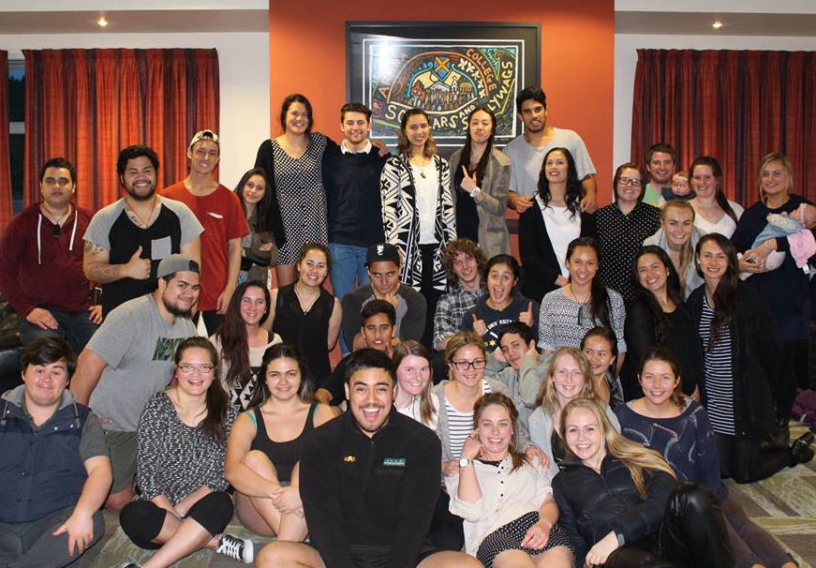
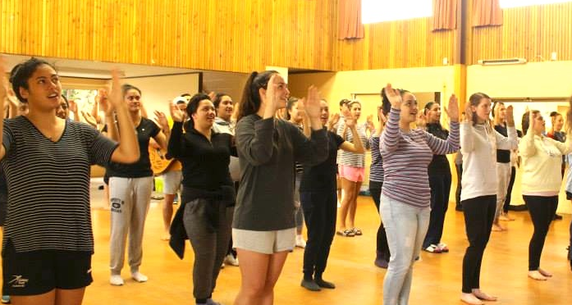
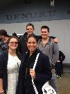


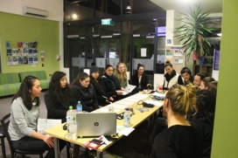
TE ARA HAUORA
TŪ KAHIKA
TE WHAKAPUĀWAI
TŪ TAUIRA HAUORA

Slide 41
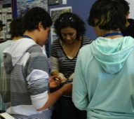
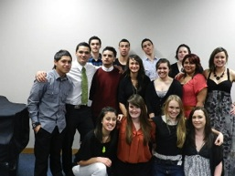
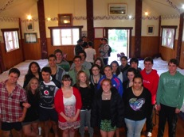
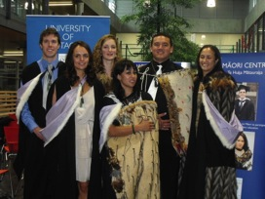
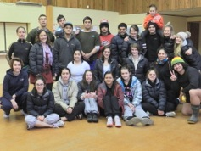
Inspiration / Aspiration
Recruitment / Transition
Retention / Achievement
Graduation
Notes:
Our work is targeted to support Maori to successfully enter into-and through university. We work from aspiration to graduation, in secondary with targeted programmes through to graduation and

