Slide 1

TE MANA ORITE
Building an Equitable Future Together

Slide 2
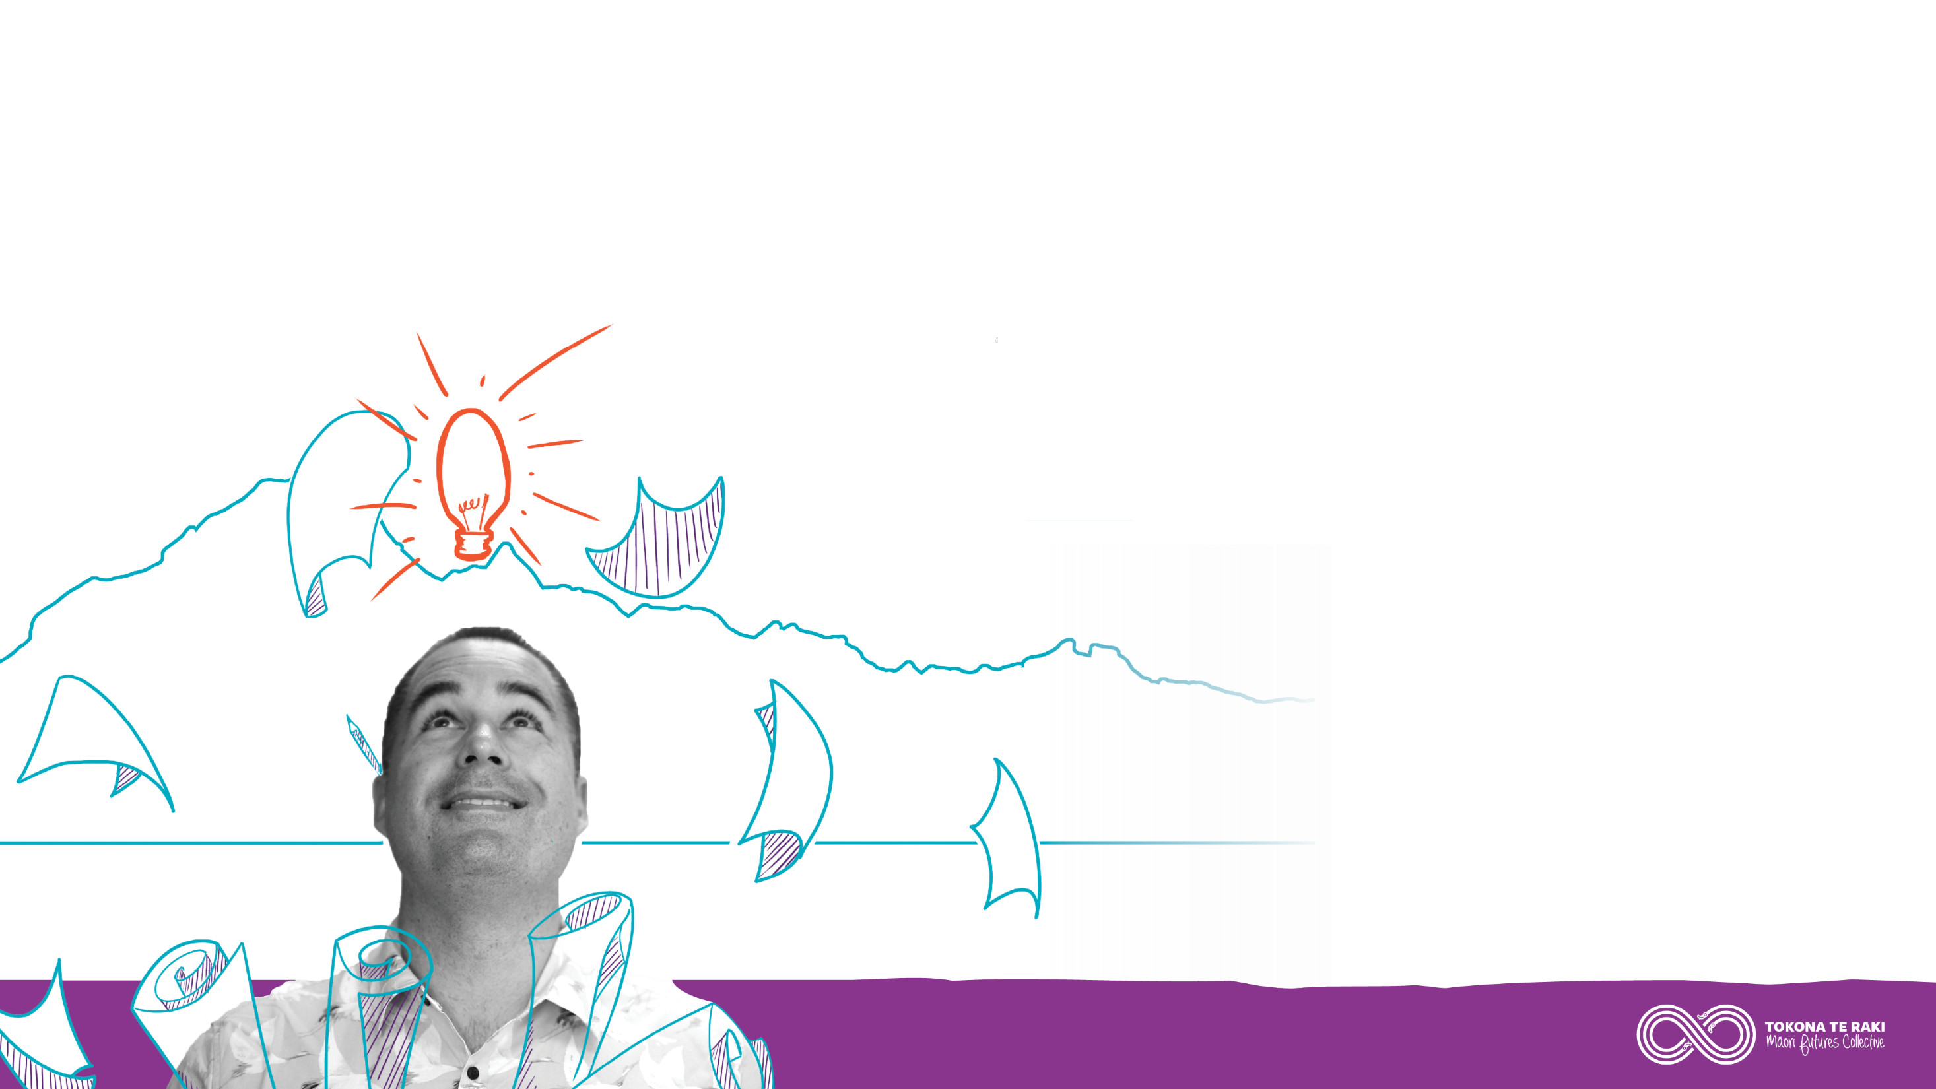
Introduction
“As we head towards 2040 and marking 200 years since the signing of the Treaty of Waitangi I believe we also have the opportunity to realise the promise of true partnership by coming together to advance a shared vision of supporting our rangatahi to build a better future.”

Slide 3

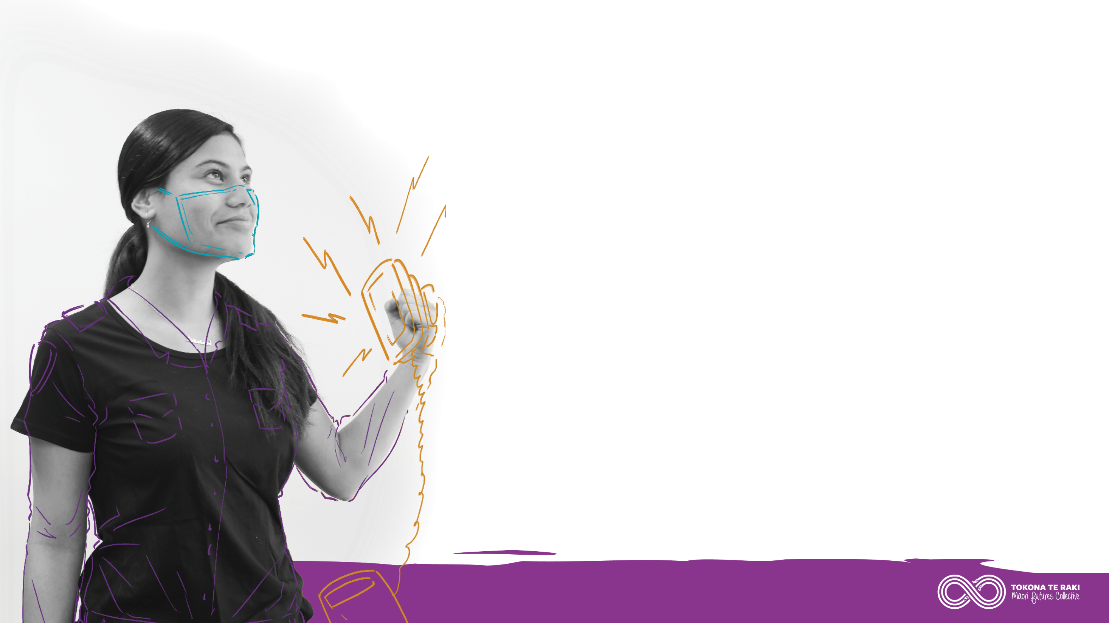

Our Vision
All rangatahi are inspired by their futures, succeeding in education as Māori, confident in their culture and prosperous in
their careers.

Slide 4
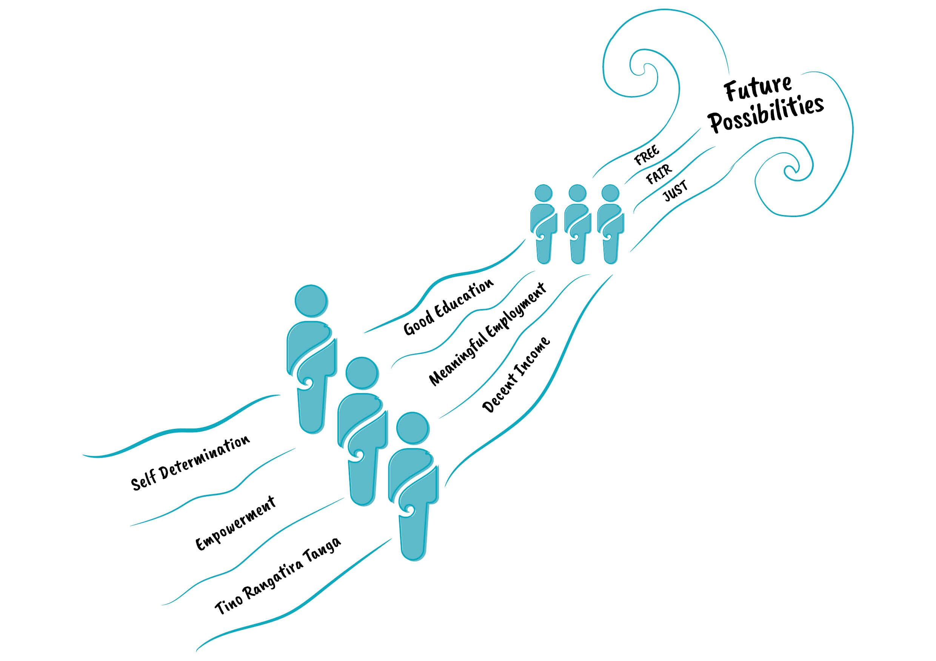

Slide 5
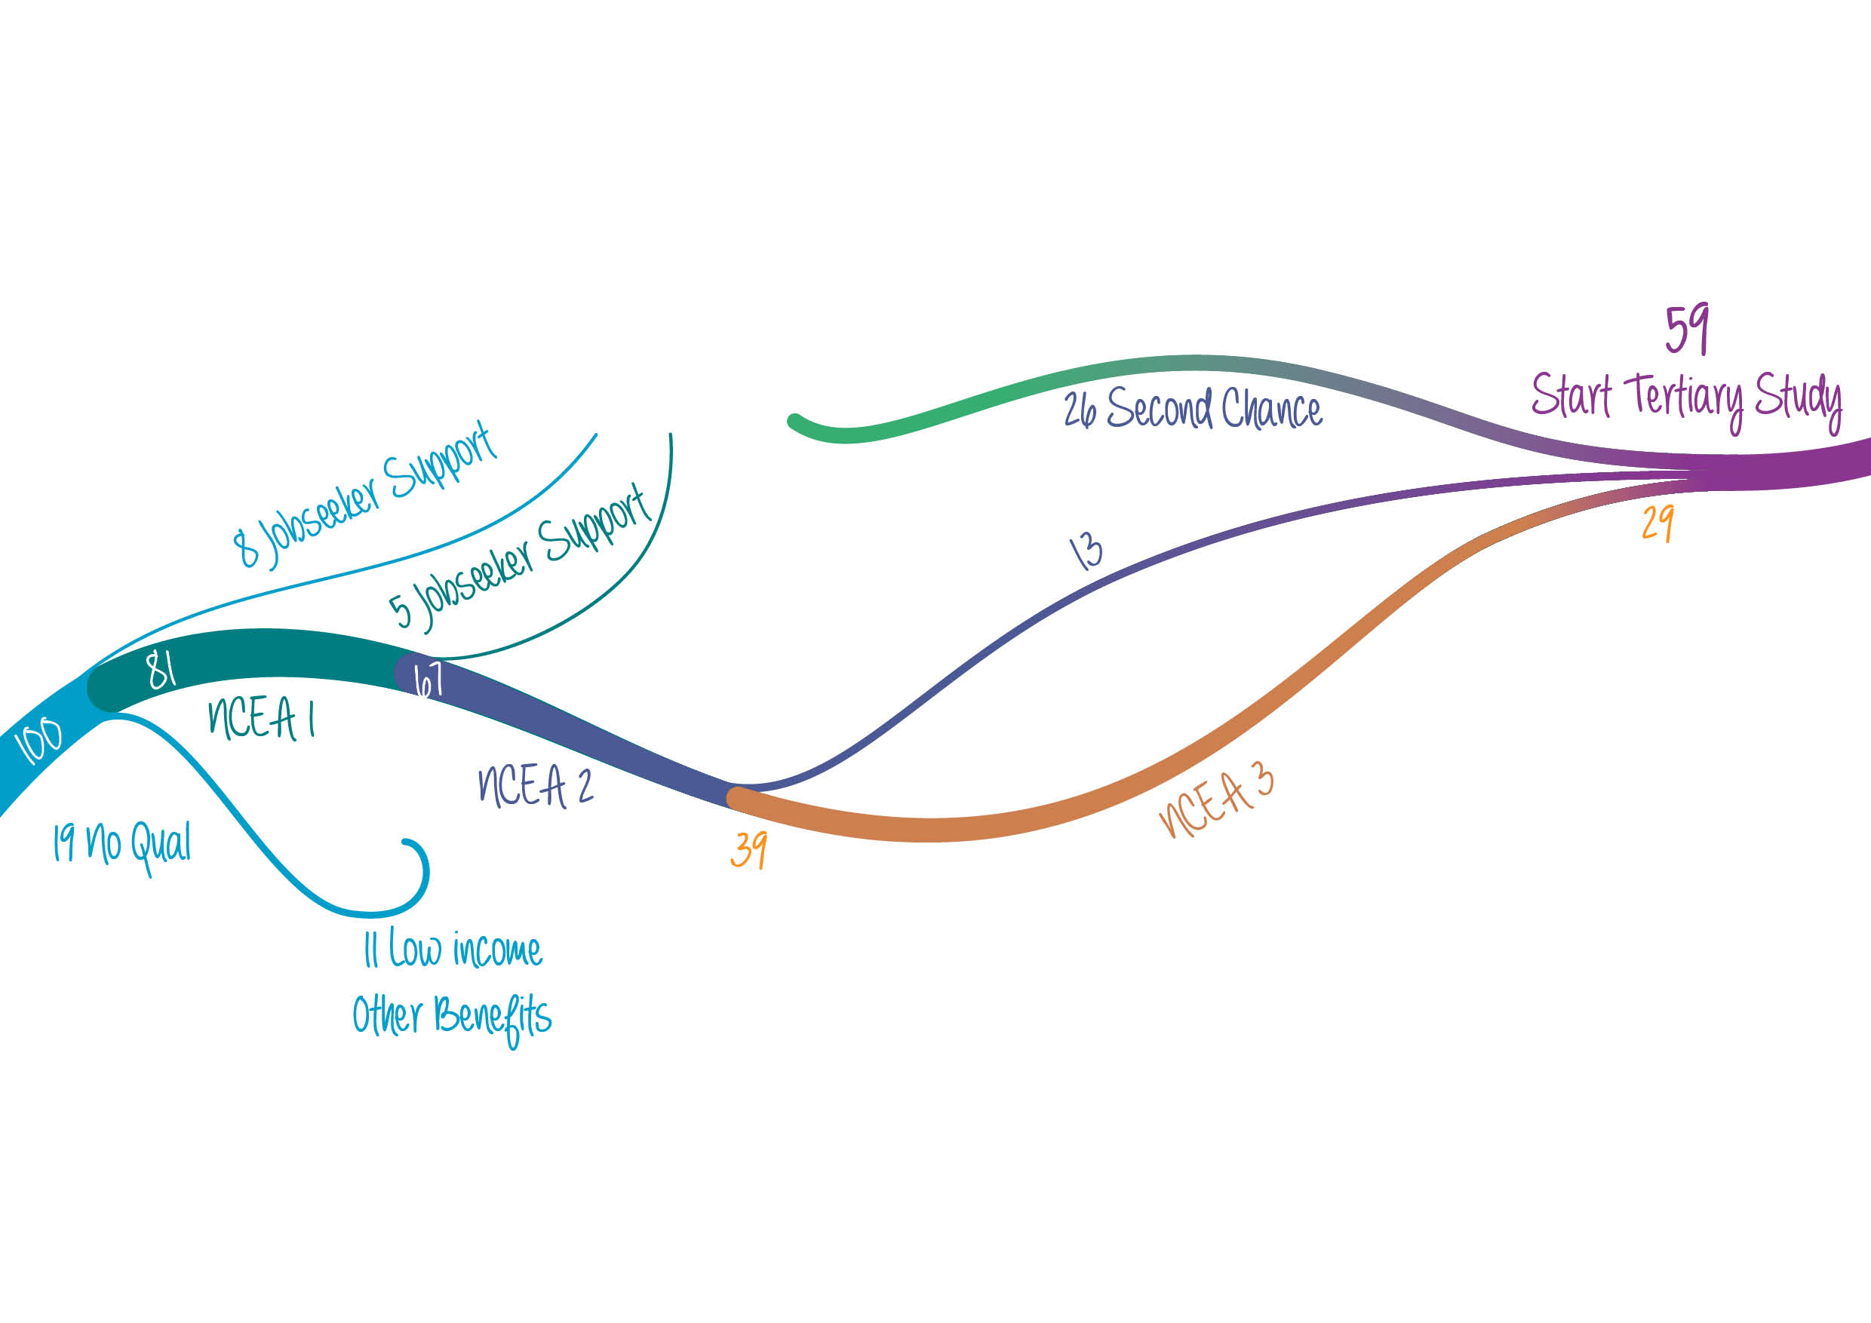

Slide 6
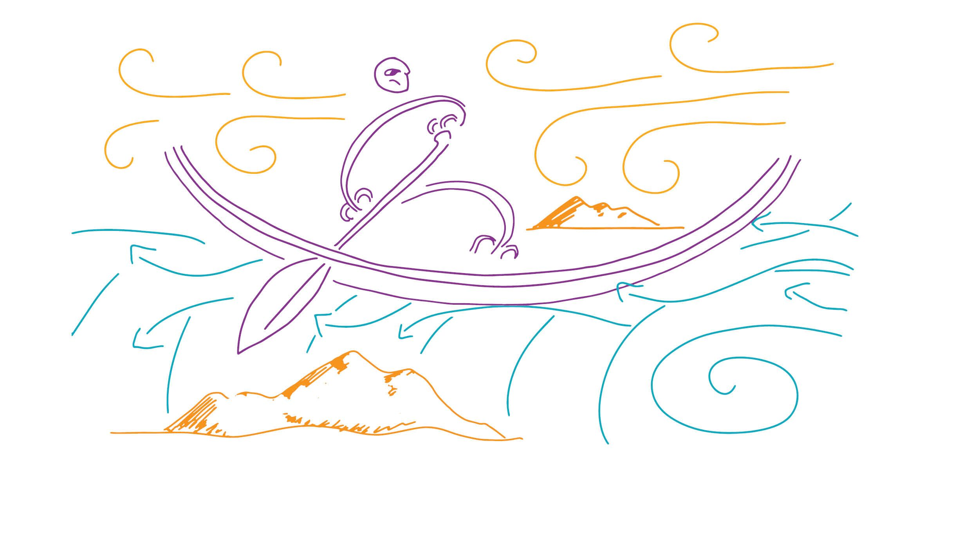

Slide 7
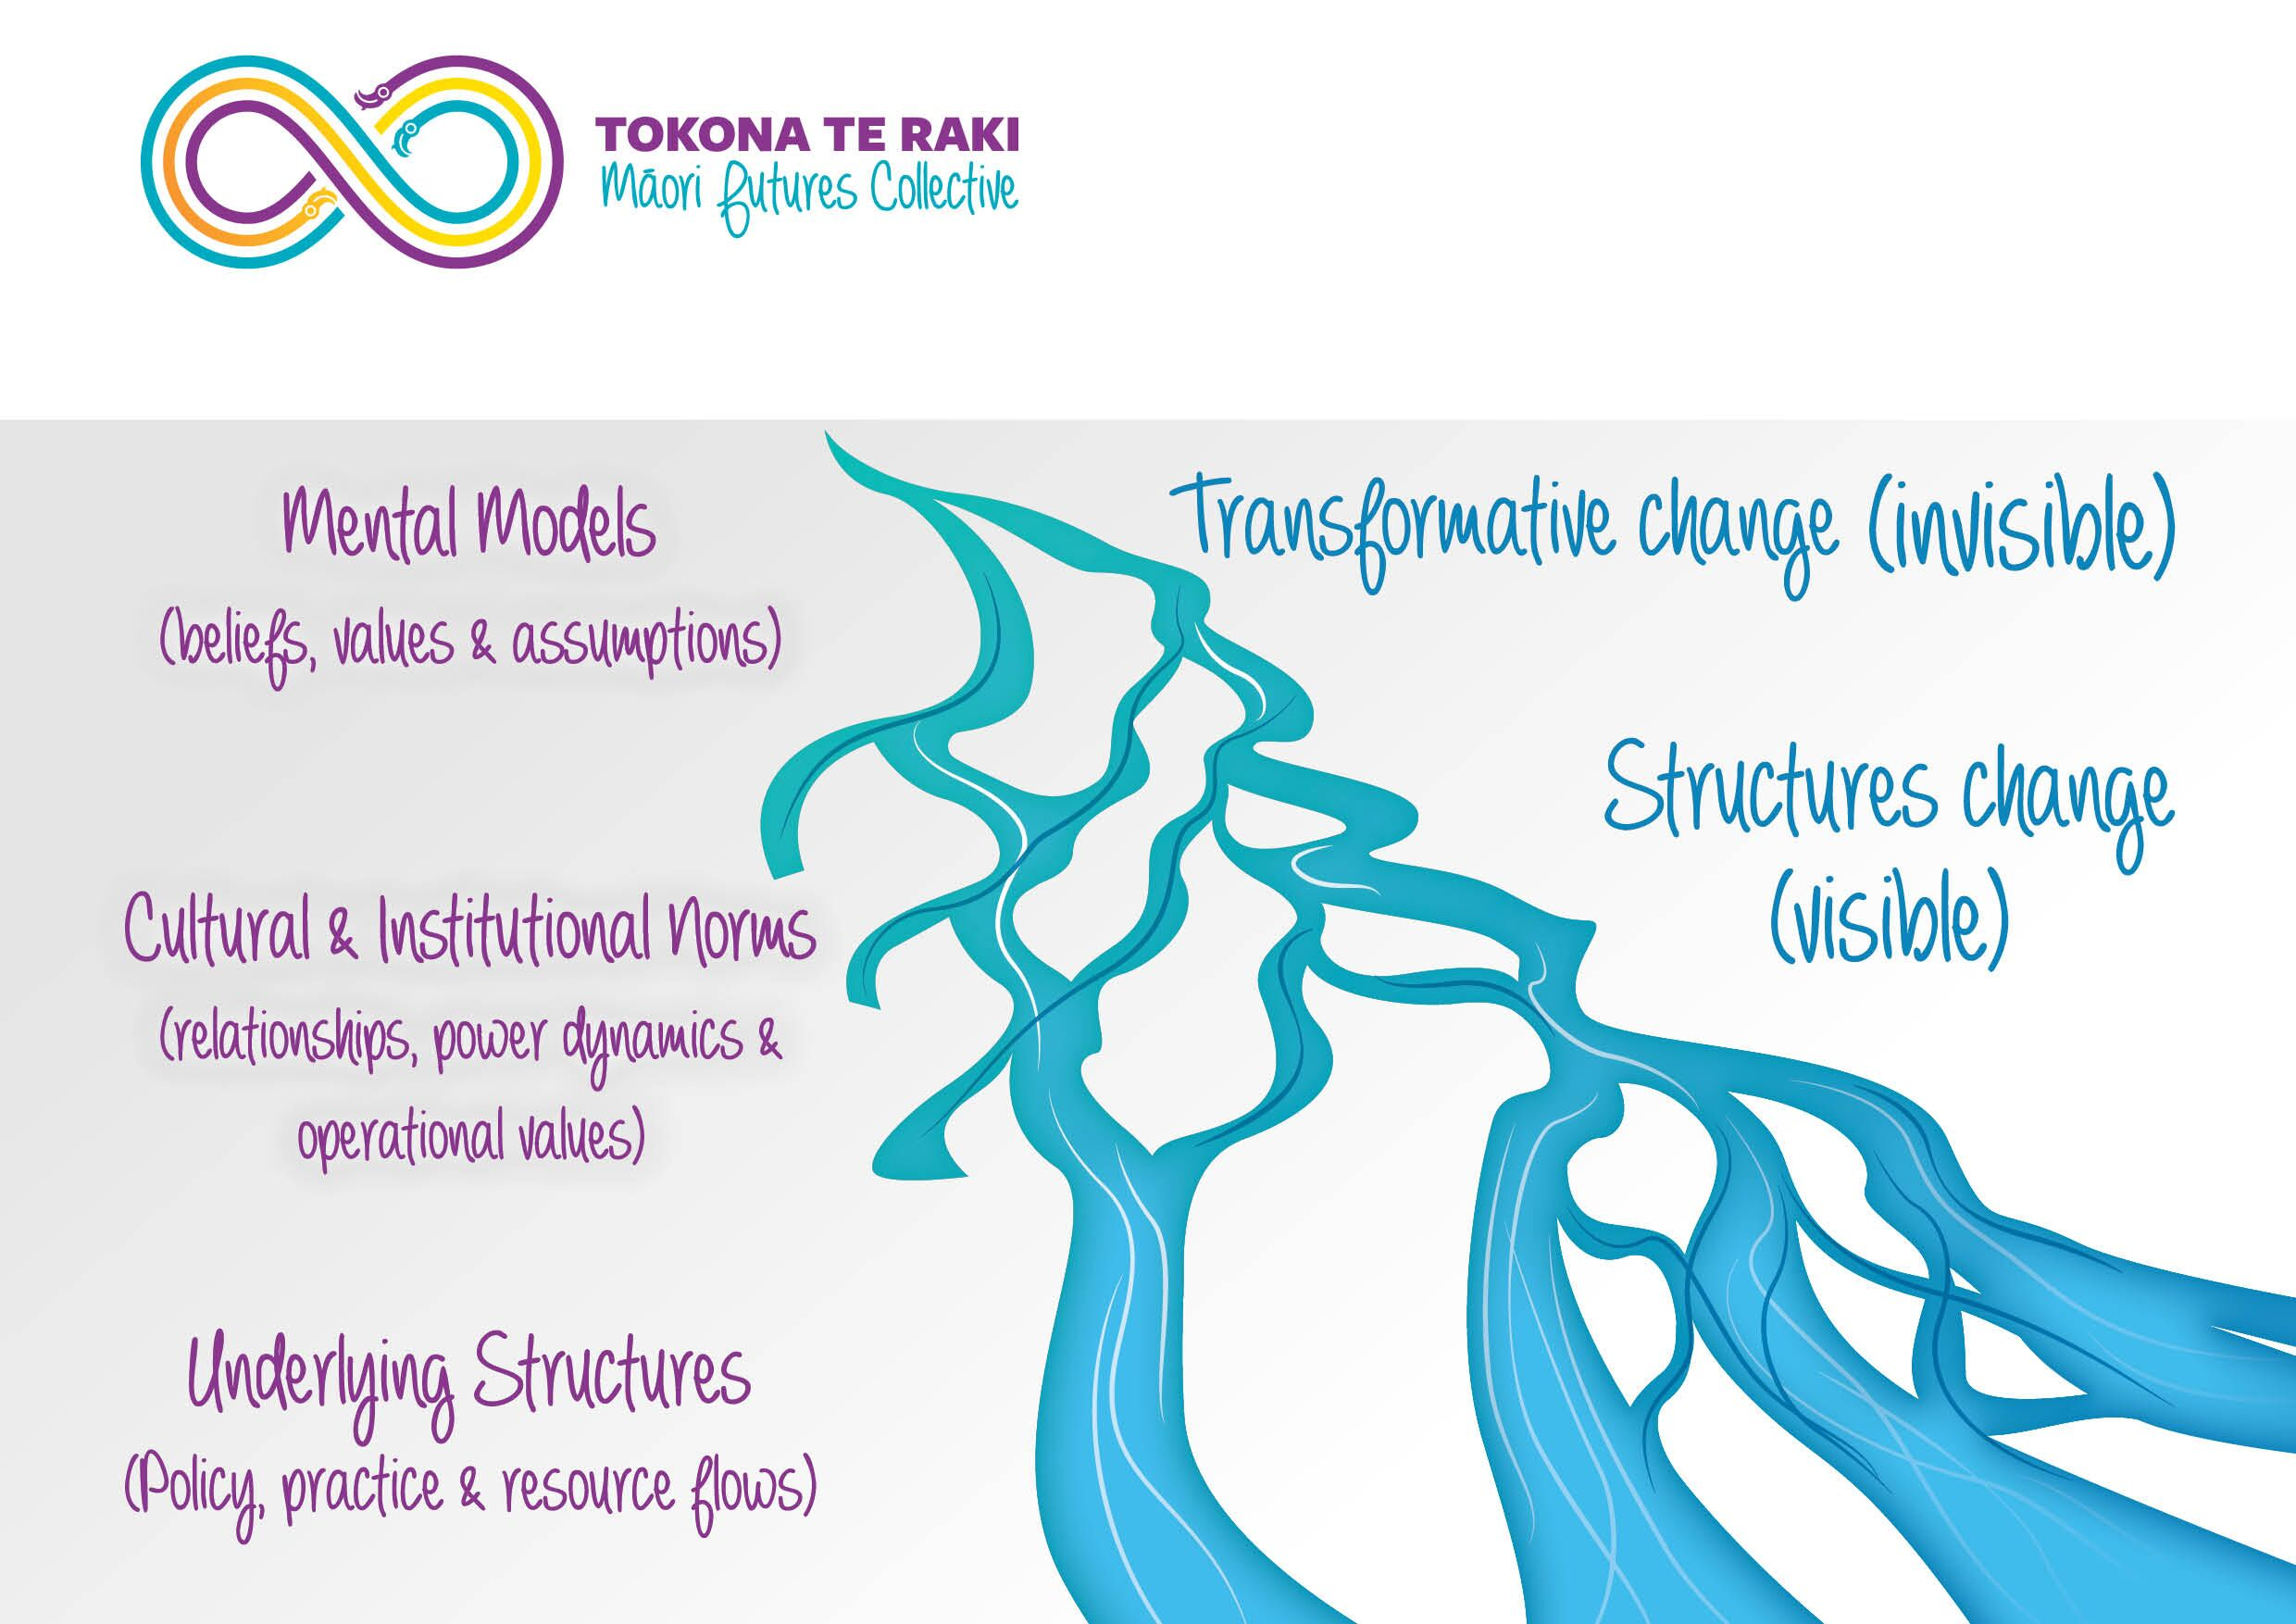

Slide 8
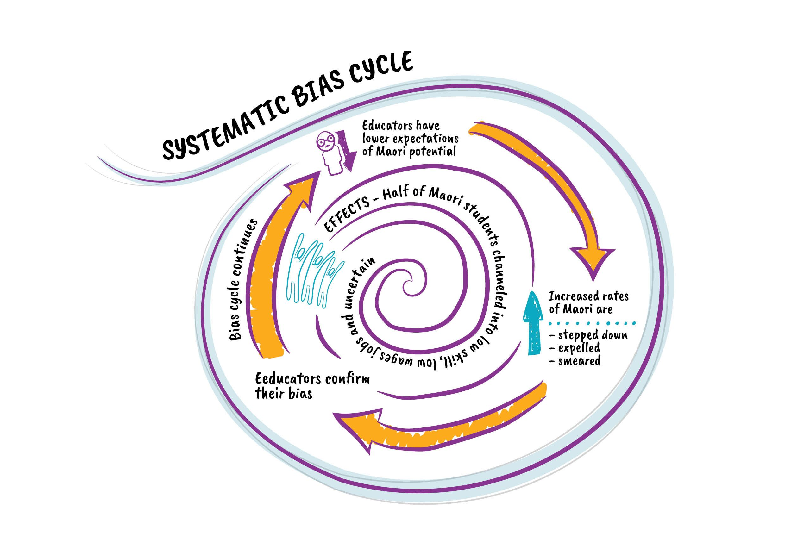

Slide 9
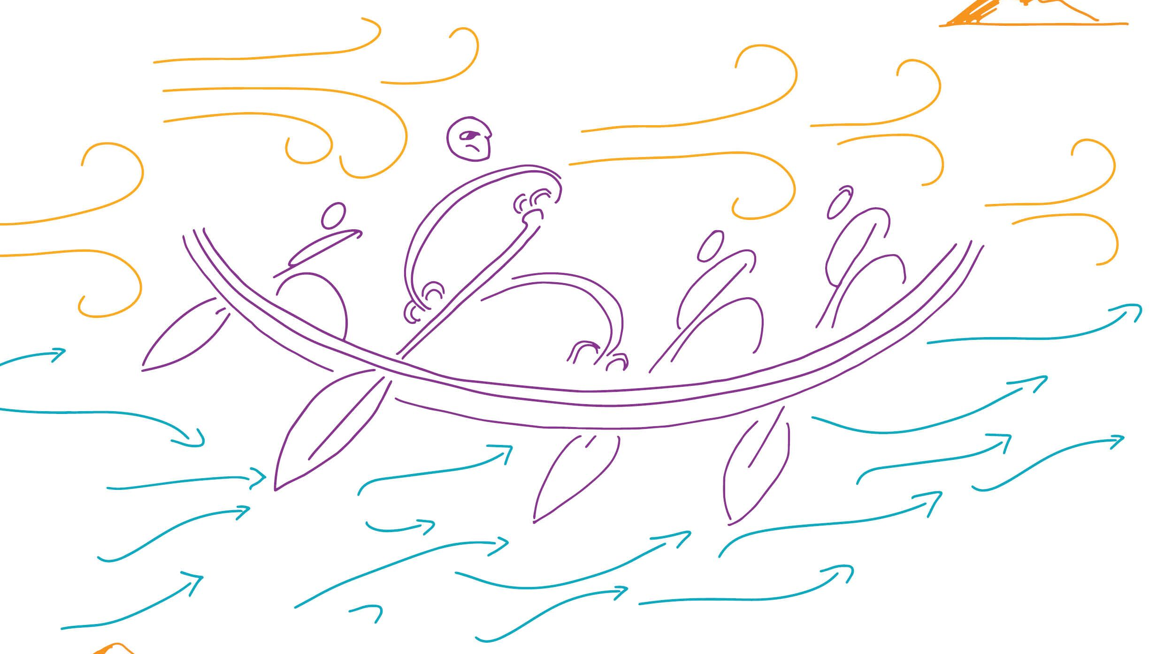

Slide 10


Thank you for watching
www.maorifutures.co.nz

